Slide 1
Series & Parallel FFT on GPU GACS-7306 Final Project Presentation
Srinivas KASTURI
3078674

Slide 2
Outline
Introduction
Literature Review
Problem Description
Theoretical Framework & Algorithm
Implementation
System Architecture
Experiments & Results
Conclusion
References

Slide 3
Acknowledgement
I would like to thank our Professor for giving me this opportunity to explore on Parallel Programming and I would like to thank my friends Surya & Siva who helped me to transfer Python code to CUDA for simulation.

Slide 4
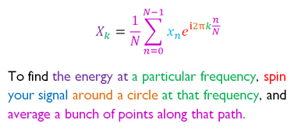
Introduction
The main goal of our project is to implement Fast Fourier transform of a function on a GPU in order to reduce its execution / running time.
Fast Fourier Transform is an optimized version of DFT which works on the principle of divide and conquer with respect to the algorithm.

Slide 5
Literature Review
The basic idea of this project was taken from the research work of Microsoft professionals whose topic is “High Performance Discrete Fourier Transforms on Graphics Processors”.
To reduce the memory transpose overheads in hierarchical algorithms by combining the transposes into a block based multi-FFT algorithm by combining two or more methods.
In-order to implement a parallel processing algorithm for FFT we choose Cooley-Turkey’s algorithm because of reduced complex operations & parallel processing.

Slide 6
Problem Description
In this project, we look forward to analyze the performance of Parallel FFT with respect to traditional Series FFT. To achieve this parallel FFT we are using divide and conquer approach to perform these operations.

Slide 7
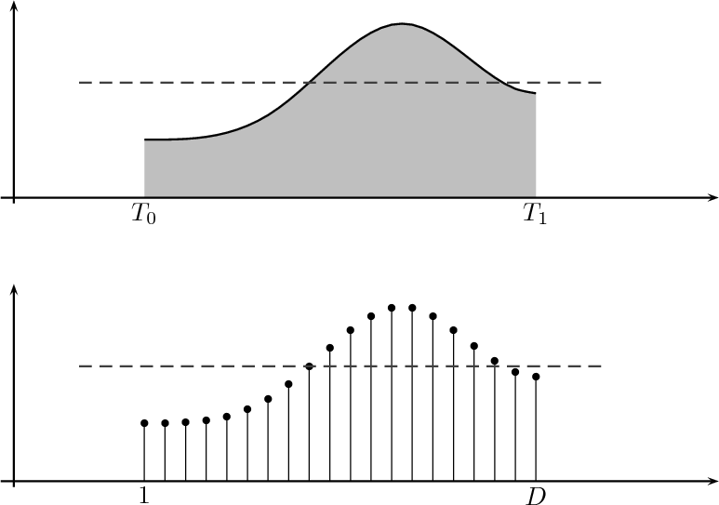
Discrete Fourier Transform (DFT): Overview
What?
Converts a sampled function from time domain to frequency domain
Use?
DFTs reveal periodicities in input data as well as the relative strengths of any periodic components

Slide 8
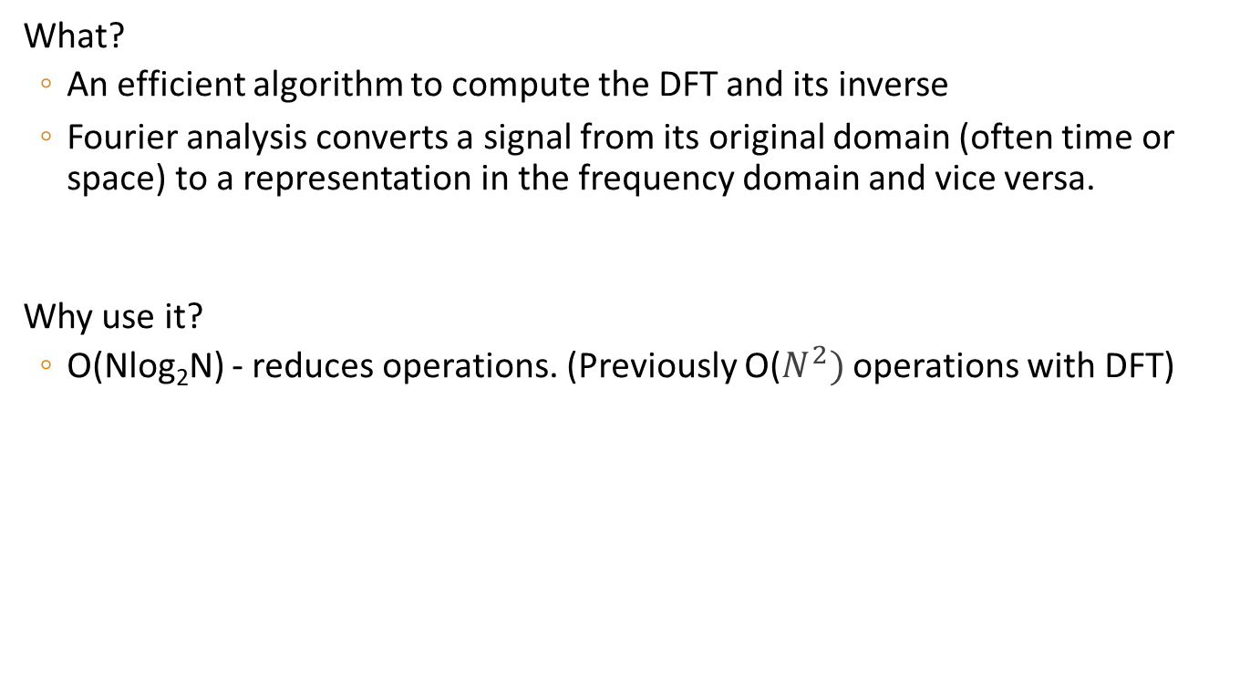
Fast Fourier Transform (FFT):
What?
An efficient algorithm to compute the DFT and its inverse
Fourier analysis converts a signal from its original domain (often time or space) to a representation in the frequency domain and vice versa.
Why use it?
O(Nlog₂N) - reduces operations. (Previously O($N^{2})$ operations with DFT)

Slide 9
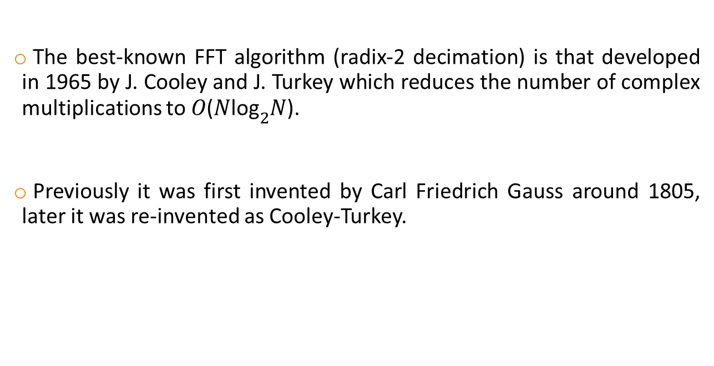
FFT: Cooley-Turkey algorithm
The best-known FFT algorithm (radix-2 decimation) is that developed in 1965 by J. Cooley and J. Turkey which reduces the number of complex multiplications to 𝑂(𝑁${\text{log}}_{2}$𝑁).
Previously it was first invented by Carl Friedrich Gauss around 1805, later it was re-invented as Cooley-Turkey.

Slide 10
FFT: Cooley-Turkey algorithm
Most common FFT algorithm, why
- Divide and conquer algorithm
Methodology
- Breaks up DFT of N samples into N=N₁N₂
Benefits
- Can be combined with any other DFT algorithm with less number of complex operations
- Mainly used in Matlab FFT function for optimization

Slide 11
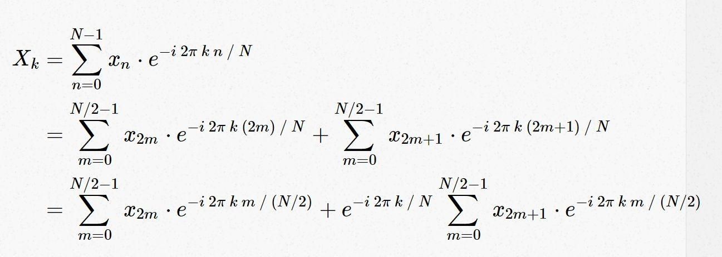
FFT: Cooley-Turkey algorithm
Input data must be a power of 2
If it’s not, data is either truncated or padded with zeros

Slide 12
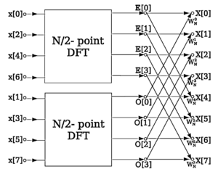

FFT: Cooley-Turkey algorithm
By doing this recursively until there is no sum, you get log(N) levels
Sum is decomposed and redundant operations appear
4 point transform
eg: 𝑁=8
Data flow diagram for N=8: a decimation-in-time radix-2 FFT breaks a length-N DFT into two length-N/2 DFTs followed by a combining stage consisting of many size-2 DFTs called "butterfly" operations (so-called because of the shape of the data-flow diagrams).

Slide 13
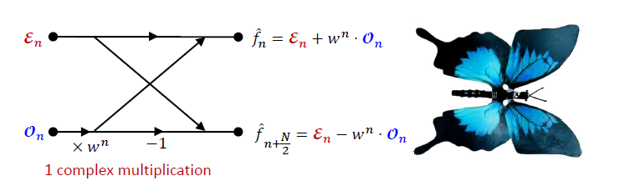
FFT: Cooley-Turkey algorithm
The operations of radix-2 decimation in Cooley–Tukey FFT algorithm can be represented by the butterfly diagram:

Slide 14
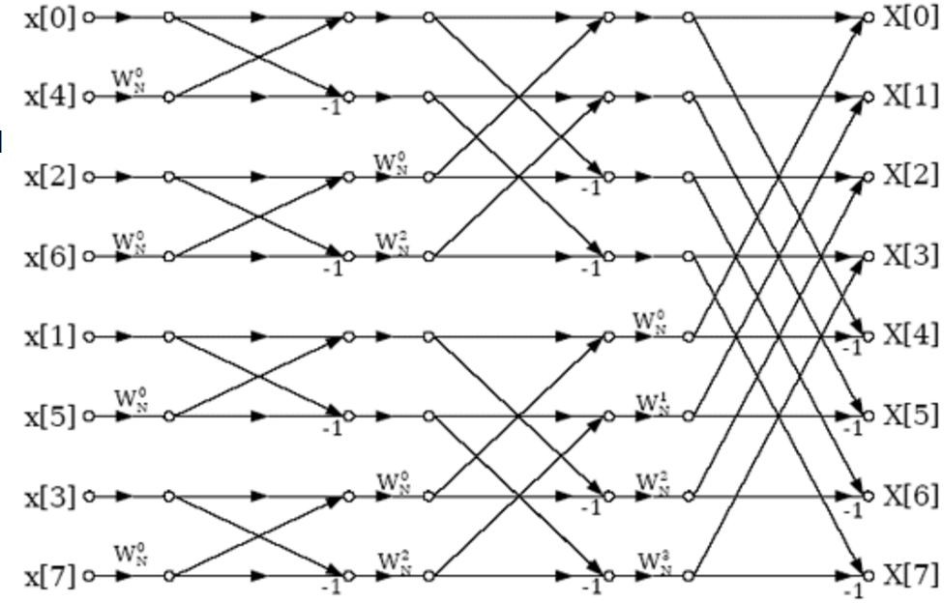
FFT: Cooley-Turkey algorithm
We can find an eight point sequence input signal, and we start with 2 point Fourier transforms. Then, we get 4 points, and 8 points Fourier transforms.
𝑁/2+𝑁/2+𝑁/2 complex multiplications

Slide 15
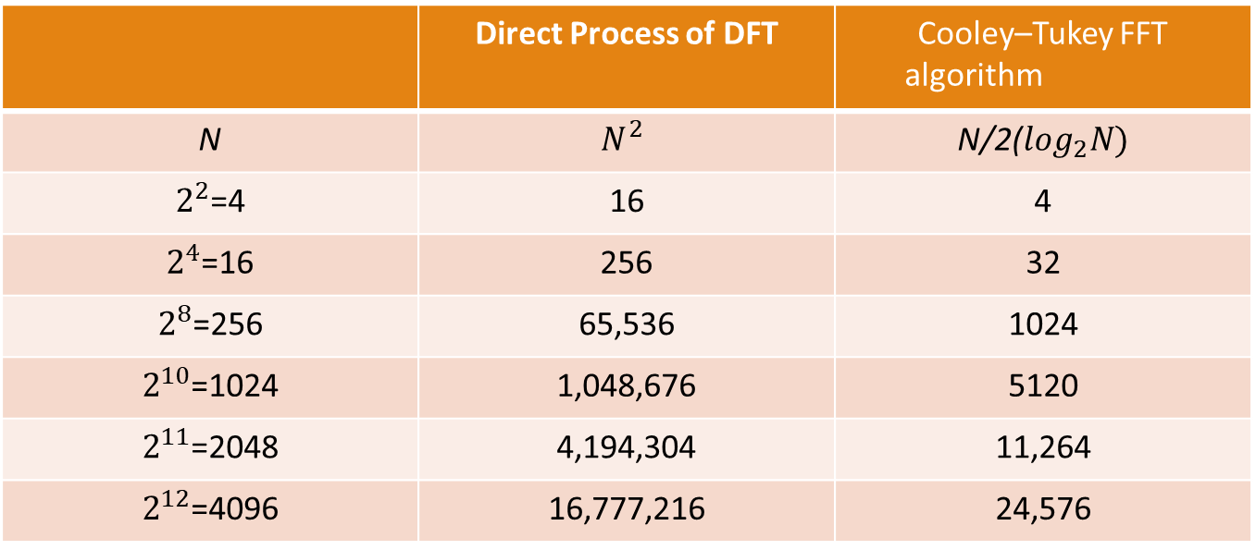
Comparison of numbers of complex multiplications
 | Direct Process of DFT | Cooley–Tukey FFT algorithm
N | $$N^{2}$$ | N/2($\log_{2}N)$
$2^{2}$=4 | 16 | 4
$2^{4}$=16 | 256 | 32
$2^{8}$=256 | 65,536 | 1024
$2^{10}$=1024 | 1,048,676 | 5120
$2^{11}$=2048 | 4,194,304 | 11,264
$2^{12}$=4096 | 16,777,216 | 24,576

Slide 16
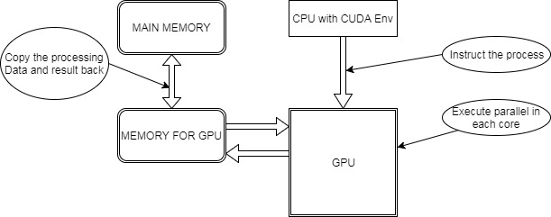
Implementation - Block Diagram

Slide 17
Implementation - Flow
(1) CUDA starts, after allocating memory in CPU, then the memory space allocation is done in the device for the input data.
(2) The host copies the memory of the data to the memory of device.
(3) In the GPU, the distribution of memory is used for storing the output data.
(4) Calling kernel function for calculation, the results into the memory of the corresponding region.
(5) CPU memory allocation, used to store the output data came from GPU.
(6) The memory of the results using CPU for data and other processing.
(7) The release of memory space in GPU.

Slide 18
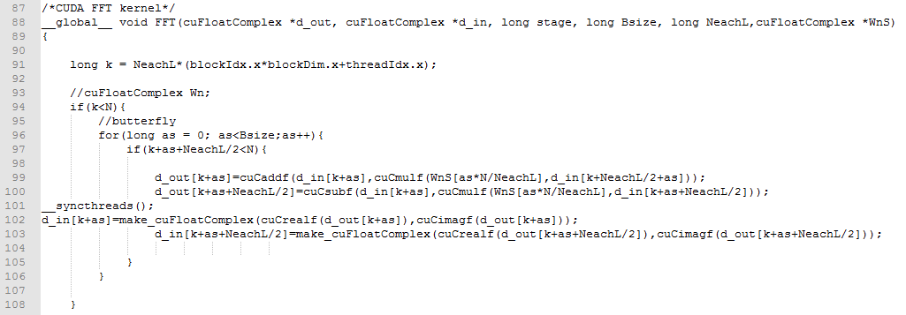
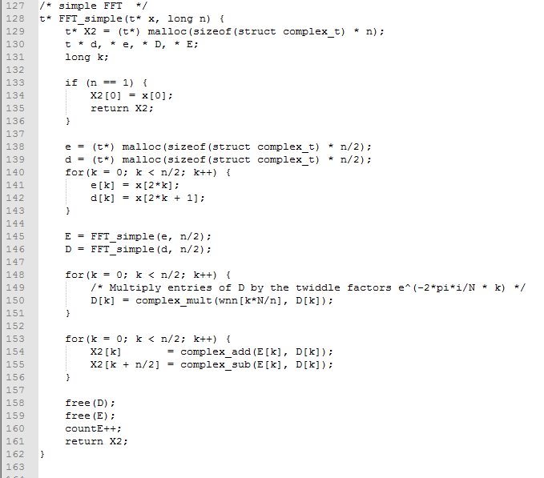
Code Screenshots

Slide 19
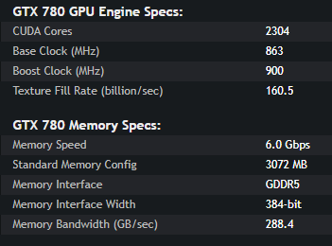
System Architecture
Software:
CUDA toolkit 6.0+
Hardware:
Host - Windows 7 or later with minimum 2GB ram and 2nd gen dual core processors.
Device- CUDA enabled GPU device with compute capability of 2.0+ higher.(GeForce GTX 780)

Slide 20
Results & Experiments
N | DFT(millisec ond) | FFT Serial(millise c) | FFT Parallel (millisec) | RMSE value (FFT serial v DFT) | RMSE value (FFT Parallel v FFT serial)
512 | 0.045761 | 0.000294 | 0.000037 | 0.000002 | 0.000001
1024 | 0.175117 | 0.000628 | 0.000041 | 0.000005 | 0.000002
2048 | 0.607248 | 0.001178 | 0.000045 | 0.000013 | 0.000003
4096 | 2.034476 | 0.002497 | 0.000049 | 0.000028 | 0.000002
16384 | 31.012565 | 0.012119 | 0.000057 | 0.000029 | 0.000009
65536 | - | 0.053196 | 0.000064 | - | 0.000022
131072 | - | 0.087167 | 0.000068 | - | 0.000027
262144 | - | 0.170273 | 0.000072 | - | 0.000050
524288 | - | 0.357368 | 0.000075 | - | 0.000079
1048576 | - | 0.737331 | 0.000073 | - | 0.000074
2097152 | - | 1.540531 | 0.000088 | - | 0.000103
4194304 | - | 3.237195 | 0.000092 | - | 0.000151
8388608 | - | 7.65048 | 0.000097 | - | 0.000263
http://calculator.vhex.net/calculator/fast-fourier-transform-calculator-fft/1d-discrete-fourier-transform

Slide 21
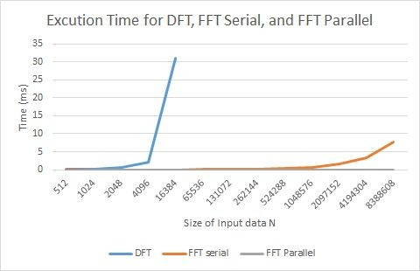
Execution time
It can be seen that running time of DFT increased exponentially whereas running time of FFT serial implementation increased almost linearly, however, on the other hand running time of parallel version remained almost constant

Slide 22
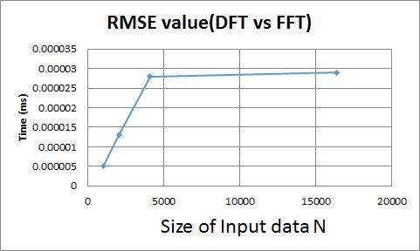
RMSE(root mean square error)
It is interesting to see that RMSE value increased sharply initially but increased rather slowly afterwards. However, it is interesting to note that magnitude increase in RMSE value still remains very less

Slide 23
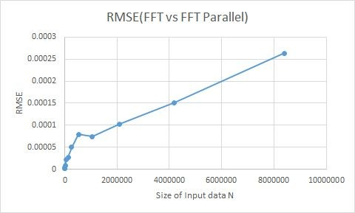
RMSE(root mean square error)
As you can see, RMSE value increases linearly but on having a closer look at the graph, it can be seen that the magnitude of increase in RMSE is very small.

Slide 24
Conclusion
FFT and Parallel FFT can reduce the computation time of DFT tremendously as can be seen from our results. We verified that our serial implementation and parallel implementation of FFT are correct as can be seen from the RMSE value which we calculated at each step.
Our parallel version has sped up the process. It can be seen that running time has been reduced considerably for parallel FFT.

Slide 25
References
[1] Naga K. Govindaraju, Brandon Lloyd, Yuri Dotsenko, Burton Smith, and John Manferdelli. High performance discrete fourier transforms on graphics processors. In Proceedings of the 2008 ACM/IEEE conference on Supercomputing, SC '08, pages 2:1{2:12, Piscataway, NJ, USA, 2008.IEEE Press
[2] An Algorithm for the machine calculation of Complex Fourier Series. By James W. Cooley and John W. Turkey. Mathematics of Computation, Vol 19,No. 90.(Apr.,1965), pp.297-301.
[3] Matteo Frigo and Steven G. Johnson. The design and implementation of FFTW3. Proceedings of the IEEE, 93(2):216{231, 2005. Special issue on \Program Generation, Optimization, and Platform Adaptation".
[4] BAILEY, D. H. 1988. A High-Performance FFT Algorithm for Vector Supercomputers, International Journal of Supercomputer Applications 2, 1, 82–87.

Slide 26

THANK YOU

